Slide 1
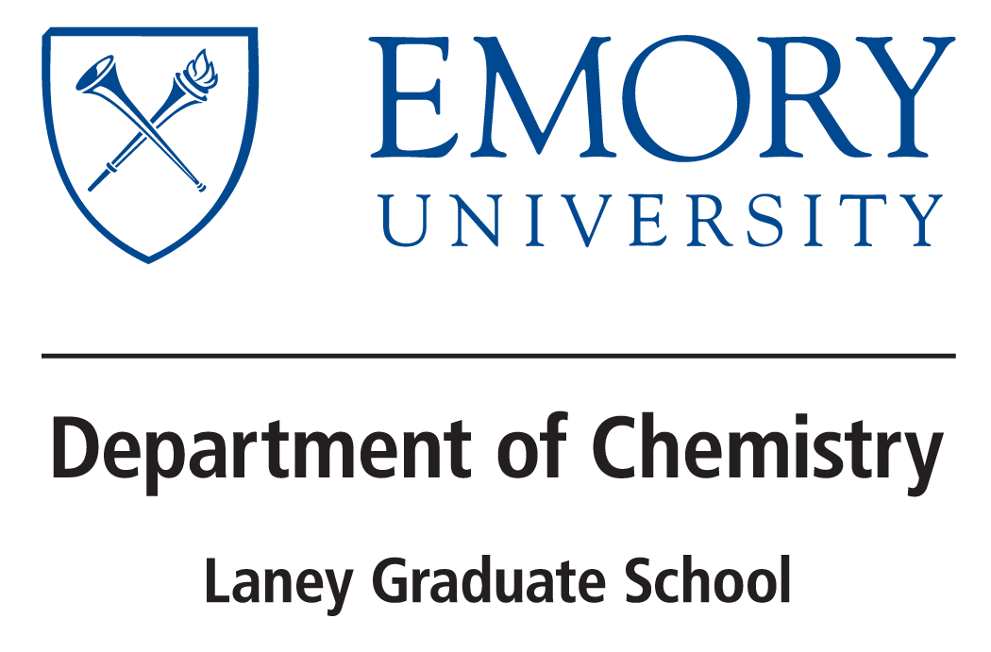

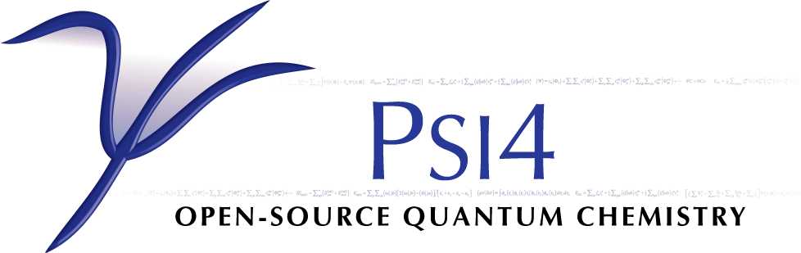



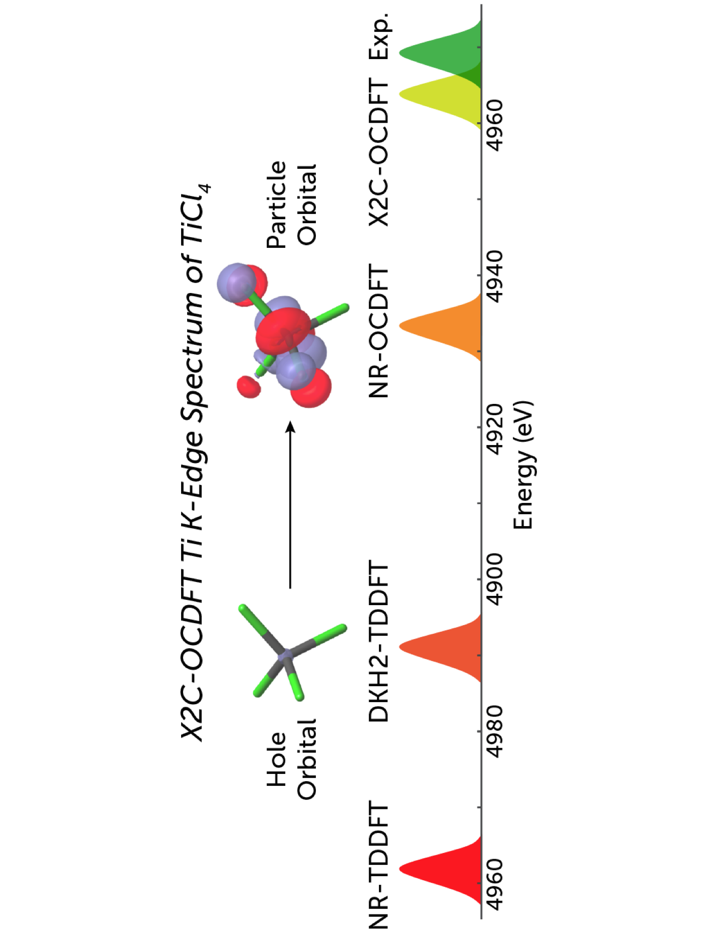
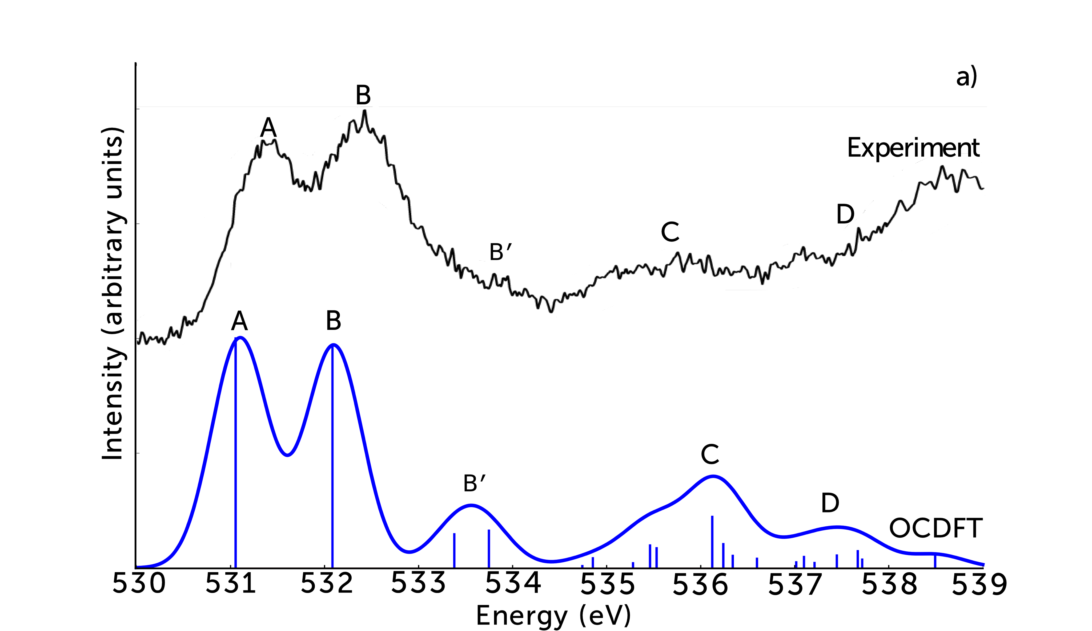
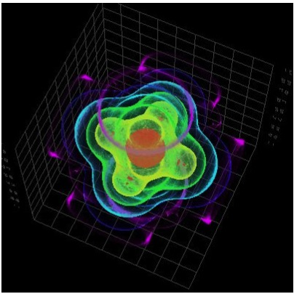
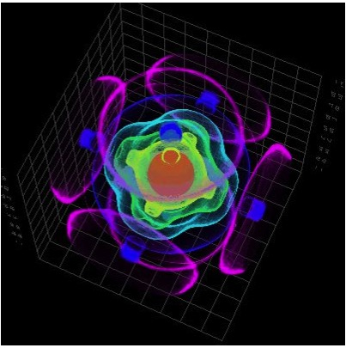
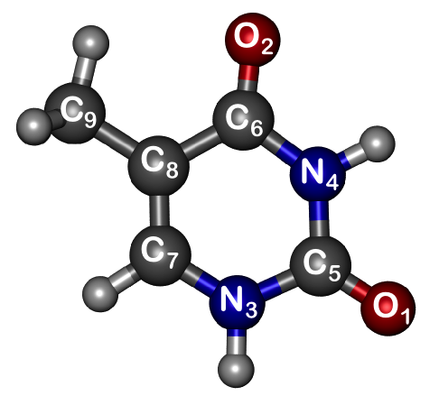


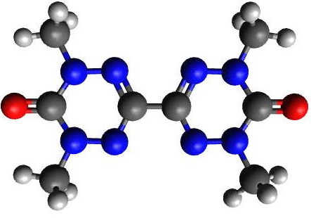
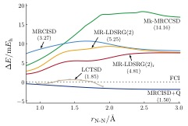
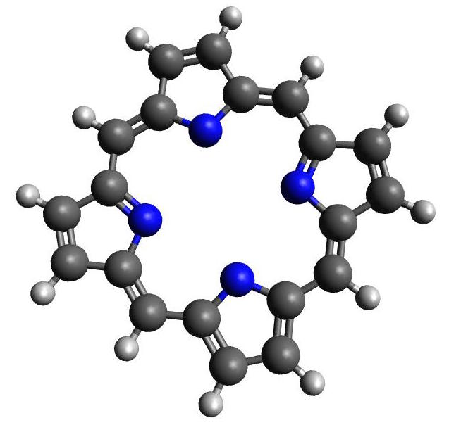
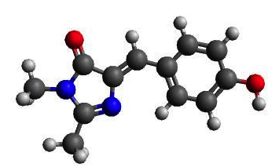



The Evangelista Lab
Dr. Francesco Evangelista, Wallace Derricotte, Prakash Verma, York Li, Kevin Hannon, Jeff Schriber, Tianyuan Zhang
Time Independent DFT Approaches for Excited States and Relativistic Effects
Wallace Derricotte: Orthogonality constrained approach to high-energy excited states
Prakash Verma: Influence of scalar relativistic effect on core excitation energies
Enforce Explicit Othogonality between all states
Chemisorbed molecules
Organic molecules
Renormalization Group Methods for Strongly Correlated Electrons
York Li: Develop robust, systematically improvable multireference many-body methods
Kevin Hannon: Efficient implementation of new multireference methods
Adaptive Electronic Structure Methods
Jeff Schriber: Selected CI methods for multireference ground and excited states
Tianyuan Zhang: Building accurate wavefunctions with the Projective CI method
CISD
FCI
Dynamical Correlation
ACI
CAS
Static Correlation
Optimize determinant space

